Slide 1
CPU Scheduling Lesson 3 Multi-Processor Scheduling
David Liu
Fall 2021, Spring 2022

Slide 2
How to define a multiprocessor?
Various system architectures
Multicore CPUs
Multithreaded cores
NUMA systems
Heterogeneous multiprocessing
Homogeneity
Identical functionality
Various funcitionalities

Slide 3
Homogenous Processors
The master server (asymmetric multiprocessing)
Symmetric multiprocessing

Slide 4
Asymmetric Multiprocessing
Master server
Scheduling
I/O processing
System activities
Other processors
Run user code
Advantage
Simple
Disadvantage
Potential bottleneck & performance

Slide 5
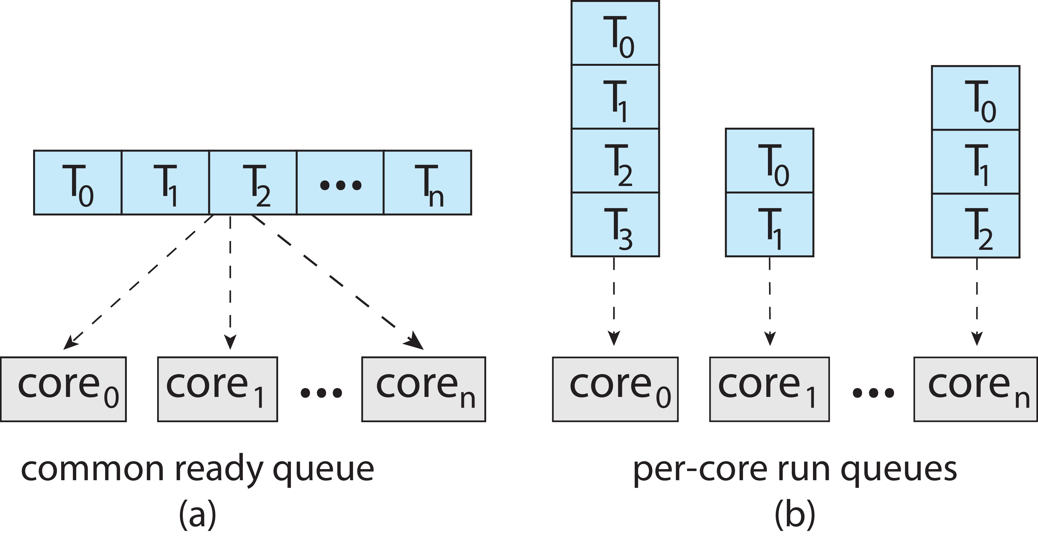
Symmetric Multiprocessing (SMP)
Each processor runs own scheduling
Common Ready Queue?
A common ready queue for all threads
Race condition by two processors
Private ready queue per processor
Most common
Load balancing?

Slide 6
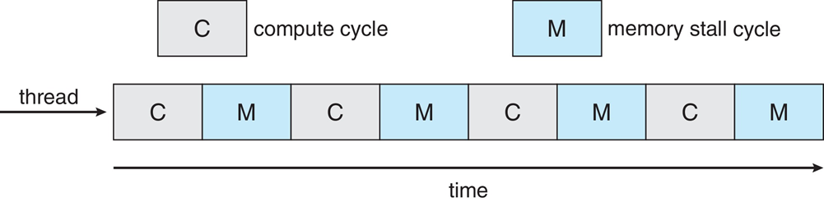
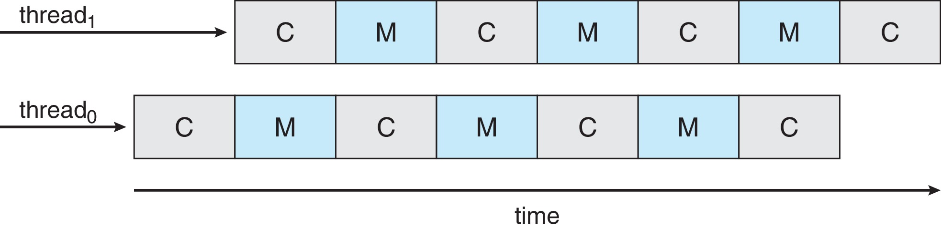
Multithread Multicore System (MMS)
A core is not fully utilized: 50% time waiting due to memory stall
Solution: two or more hardware threads per core (CMT)
Instruction pointer
Register set

Slide 7
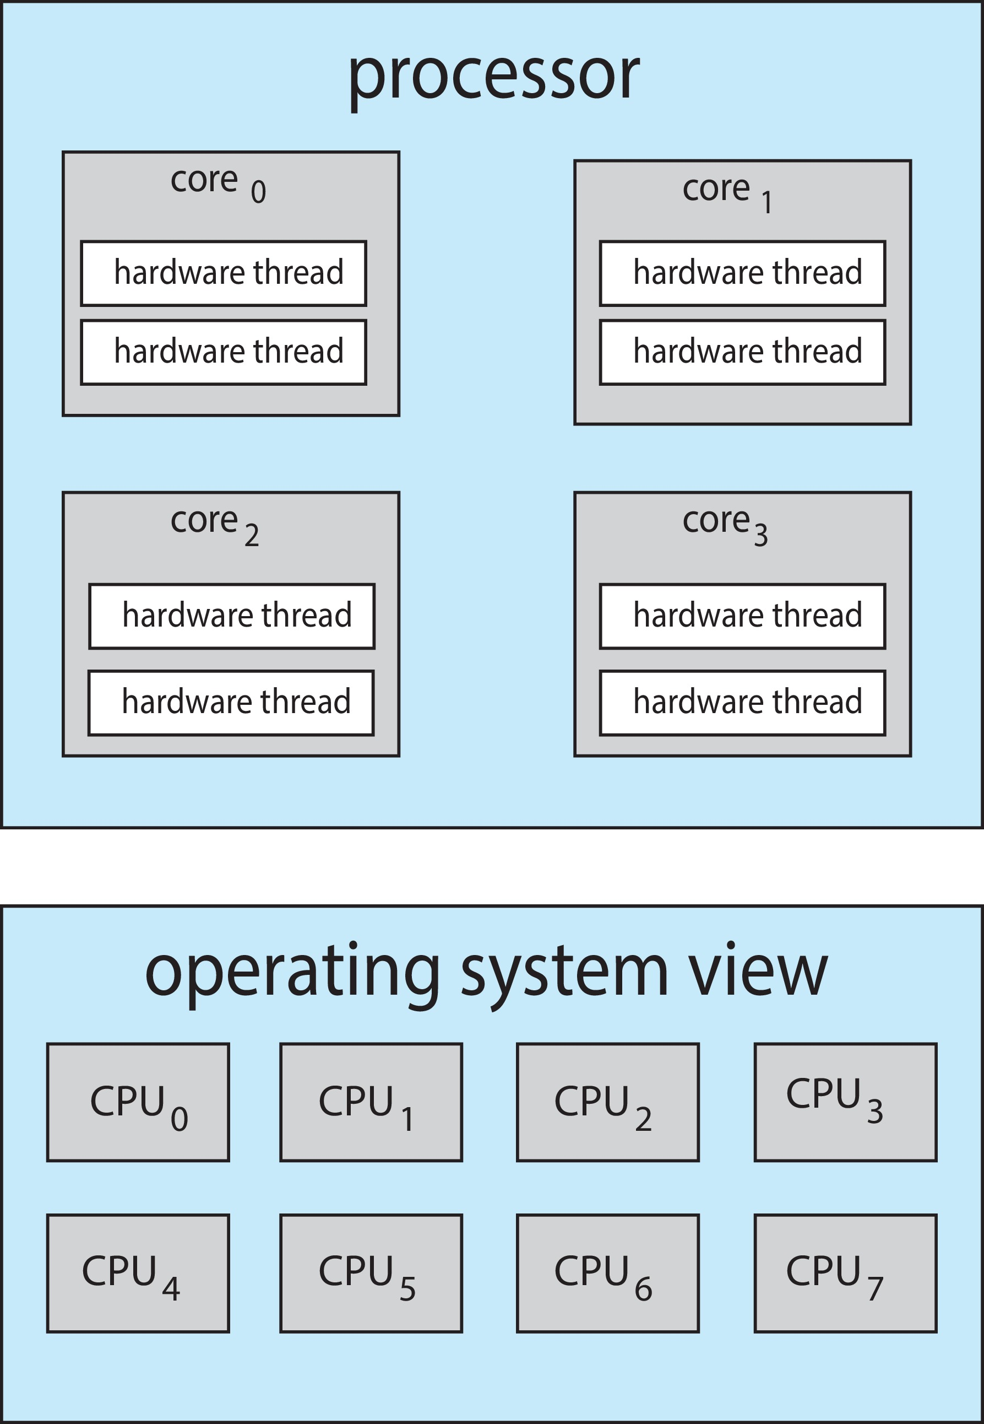
Logical CPUs
Chip-multithreading (CMT) assigns each core multiple hardware threads. (Intel refers to this as hyperthreading.)
On a quad-core system with 2 hardware threads per core, the operating system sees 8 logical processors.

Slide 8
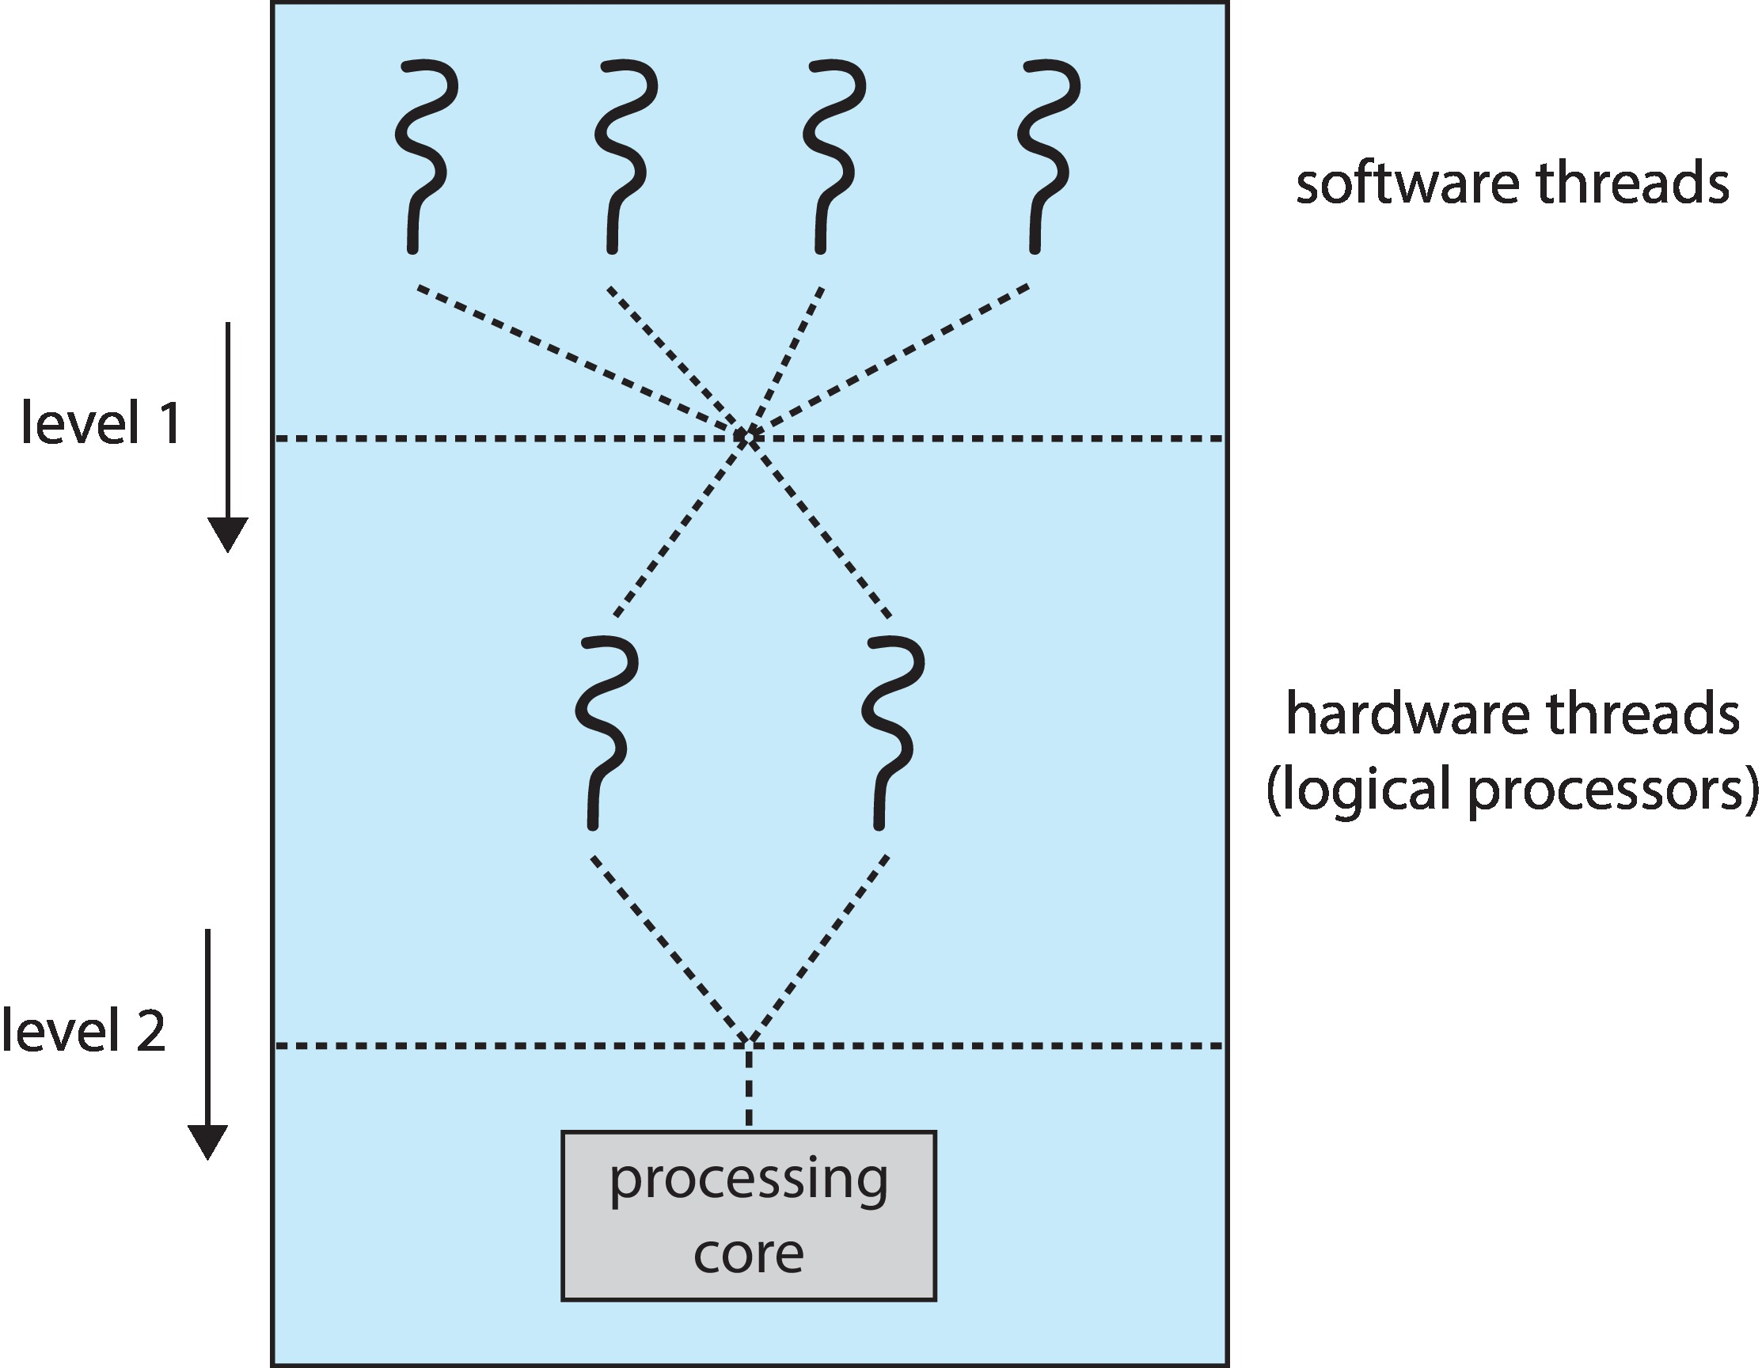
MMS Two Level Scheduling
Two levels of scheduling:
The operating system decides which software thread to run on a logical CPU
Each core decides which hardware thread to run on the physical core.

Slide 9
SMP Load Balancing
Private ready queue/core
Balancing Acts
Push migration
periodic checks load on each processor, and if found pushes task from overloaded CPU to other CPUs
Pull migration
idle processors pulls waiting task from busy processor
Doing both?

Slide 10
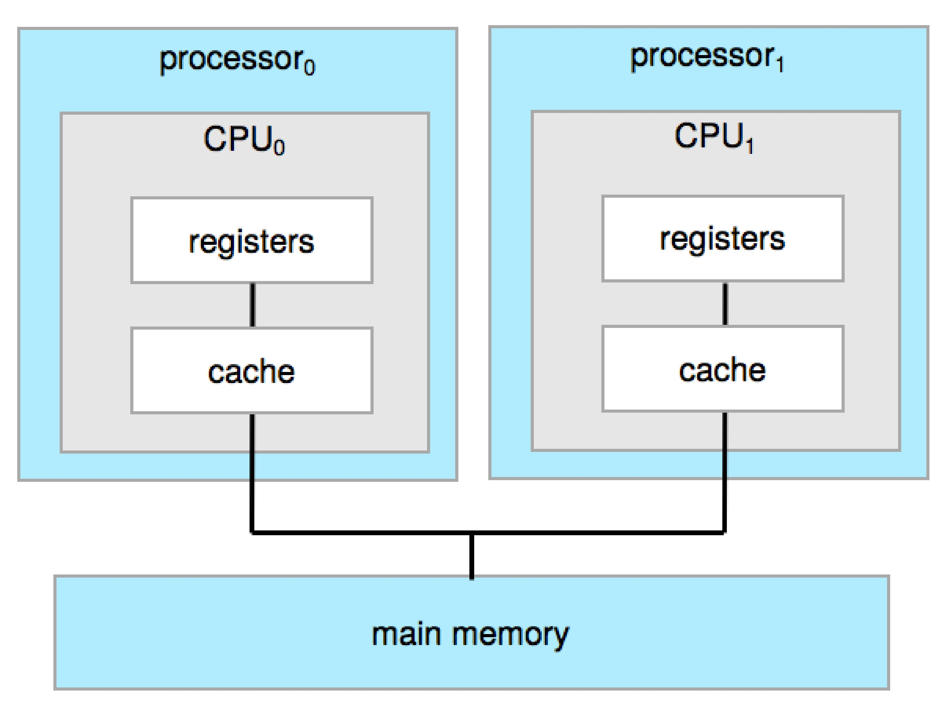
Migrate or Not
A thread may have large cache contents within a processor
Know as: processor affinity
Migration:
Thread’s cache contents invalidated in 1st processor
Thread’s cache repopulated in 2nd processor

Slide 11
Load Balancing vs Processor Affinity
Soft affinity – the operating system attempts to keep a thread running on the same processor, but no guarantees.
Hard affinity – allows a process to specify a set of processors it may run on.

Slide 12
NUMA and Processor Affinity
If the operating system is NUMA-aware, it will assign memory closes to the CPU the thread is running on.

